Slide 1
Design of a Solar sign Analysis system
By:
Joshua Trow and Kevin Eiser
Sponsored by FALA Technologies

Slide 2
Table of Contents
Introduction
Hardware
Core
Power Supply
Storage
Firmware
Software
Analysis

Slide 3
Introduction
Sign is already on the market
Users ask for more information
Trouble shooting information

Slide 4
Overview
Base product (sign) already exists
Module records sign output data
Voltage, current, temperature
Low power
Self contained
Single external cable for serial transfer
Not piggybacked off of solar power

Slide 5
Design Requirements
Wide Temperature Range
-40°C to 85°C
Shock Protection
3 ft drop onto concrete
Long battery life
90+ days without user interaction
Small Size
Less than 6” cube
Price
Less than $125 in bulk

Slide 6
Design Approach
Hardware
Incoming data is 1200/9600 Baud RS-232
Need to save data for over 90 days
Firmware
Low power major factor
Software
Error check
Make pleasing and informative graphs

Slide 7
Designer Backgrounds
SUNY New Paltz classes
Digital System Design
Embedded Systems
Microprocessor Systems
All based on 68HC12/HCS12
Assembly
Too low level for a project of this size
Alternative:
Atmel 8-bit RISC microprocessors

Slide 8
Atmel 8-Bit RISC Family
Simple to program
C/Wiring hybrid
C provides basic layout, core processing
Wiring provides simplicity/readability
Convenient demo/practice board
Arduino
Open Source
Very active user base
Many user contributed libraries
Low power shutdown modes

Slide 9
Arduino Software
Simple but powerful
Toolbar compile/upload
Built in serial monitor
Similar to Hyperterminal
Compiler shows current file and maximum size

Slide 10
Arduino Hardware
Clean layout
All usable pins brought to edges
Easily replaceable core chip
Can work as chip holder for programming if necessary

Slide 11
Hardware Flowchart

Slide 12
System Design
Arduino/ATMega core
1.8-5.5V safe operating range
SD card
Mass storage
Around 1MB/day
2.7-3.6V safe operating range
MAX232 family chip
Serial level conversions
3.3 – 5V safe power supply range

Slide 13
Power Supply Design
MAX651
DC/DC switching power supply
Up to 95% efficient at loads up to 2.5A
3.3V output with input up to 16V
Support components
Current sense resistor
Inductor
Diode
P-Channel MOSFET
Filtering Capacitors

Slide 14
Electronic Schematic

Slide 15
Power Supply Circuitry

Slide 16
Power Supply Layout

Slide 17
Alpha System Test

Slide 18
Alpha System

Slide 19
Alpha System

Slide 20
Power Consumption, Ideal
Active modes
ATMega328P – 2.13 mA
MAX3232E – 1 mA
SD –specified to 250 mA
Idle modes
ATMega328P - .4 mA
MAX3232E – 1 mA (no low power mode)
SD – 1 mA?
((.5+1+2)/1000)*24*180 = 15.12 Ah

Slide 21
Beta/New Paltz Prototype

Slide 22
Actual Power Requirements
Active Mode
With 3.3V regulator (LM7833), 5V source
9.6 mA average source current
Regulator datasheet specifies 4.5 mA bias
9.6 - 4.5 = 5.4 mA
Figuring 6 mA
(6/1000)*24*180 = 25.92 Ah
A 26 Ah battery will last 180 days at current power levels, WITHOUT power regulator
Seems unrealistic to assume use this way
DC/DC switching power supply

Slide 23
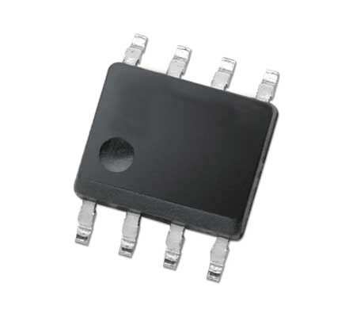
DC/DC Switching Power Supply
Uses the MAX651 SOIC-8 chip
Takes input voltage up to 16V, provides 3.3V at output
Operates at up to 95% efficient
In our operating conditions, closer to 75%
Still much better than the 50% for the linear regulator
Complex and restrictive layout
(5.4mA/.75/1000)*24*180=31.04 Ah
31.04Ah*3.3V=102Wh/12V=8.6Ah
8.6Ah, 12V battery is reasonable

Slide 24
Firmware
Reliably receive and store data
Four Parts
Avr/sleep.h
Gives the option to call a function to enter the device to sleep mode, simplifies setup
Fat16.h
File structures
SdCard.h
Interface to card
EEPROM.h
Allows access to EEPROM

Slide 25
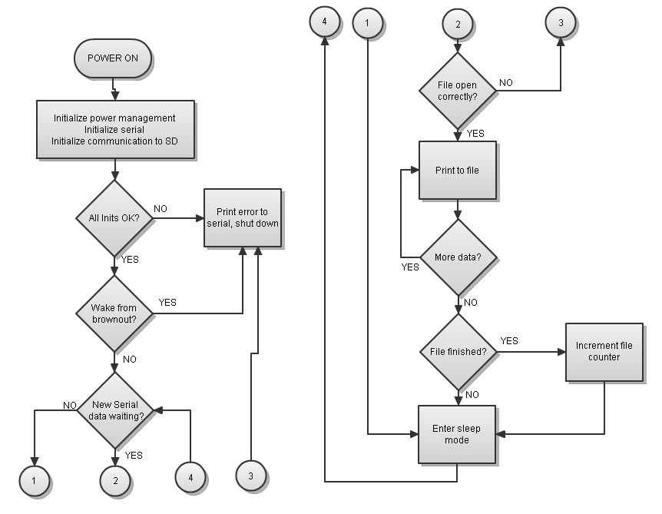
Firmware Flowchart

Slide 26
Software Design
User Friendly
Show how the sign is working
Check sign for errors
Show potential power savings
Track Sunrise and Sunset times
Calculate Power Saved
Show how battery is used

Slide 27
Software Design
Check to ensure sign is working
LEDs on or off at right times
Battery charges
Duty Cycle
Check to ensure sign is saving power
Battery low = lower duty cycle

Slide 28
Software Design
Must be self contained
Easy to use
Show graphical analysis

Slide 29
Software Design
Initially used JAVA
Background from Computer Science I and II at SUNY New Paltz
Switched to MatLab
Background from Computer Simulation Lab
Stand-alone Issues
Economical
Switched back to JAVA

Slide 30
Alpha Software
JAVA
Arrays
Array vs. ArrayList
Memory Space
Input
Log from Data Logger
Output
Tab separated File to be imported by Excel

Slide 31
Use of Excel
Excel
Pros
Easy to graph
Easy to Navigate
Cons
Import overwrote entire file
Could not maintain Excel Code

Slide 32
Beta Software
MATLAB
Ease of programming
Less code
Simple GUIs
Powerful Graphing
Stand-alone issues
Built-in Library pack that must be installed
257 MB
Full compiler cost $8000

Slide 33
Beta Software
All for demonstration purposes
Getting familiar with work environment
Learning what needs to be researched

Slide 34
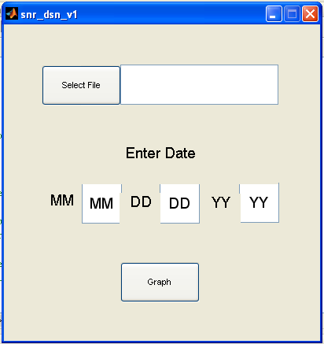
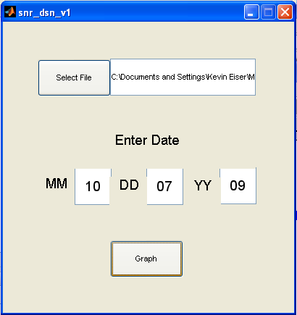
Beta Software GUI

Slide 35
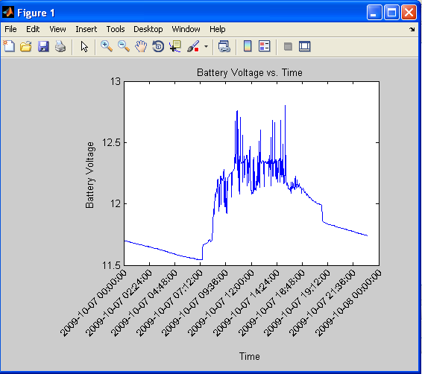
Beta Software Output

Slide 36
First Java Graphing Software
Hand coded

Slide 37
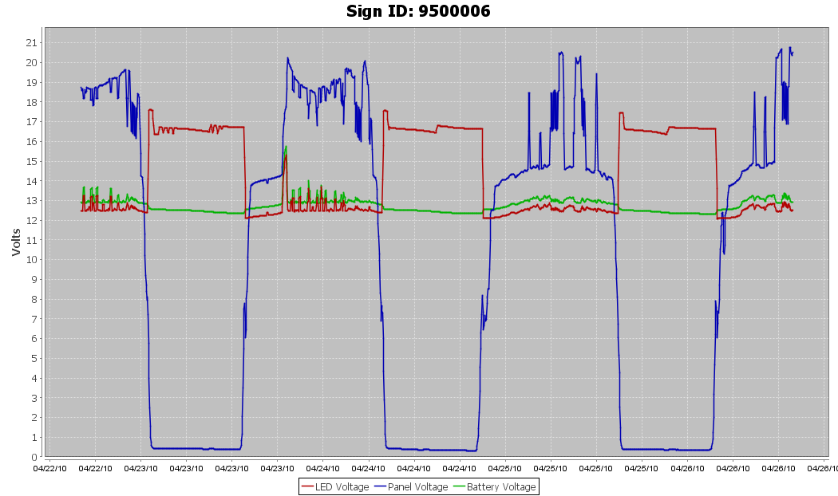
Current Graphing Software
JFreeChart (jfree.org/jfreechart)

Slide 38
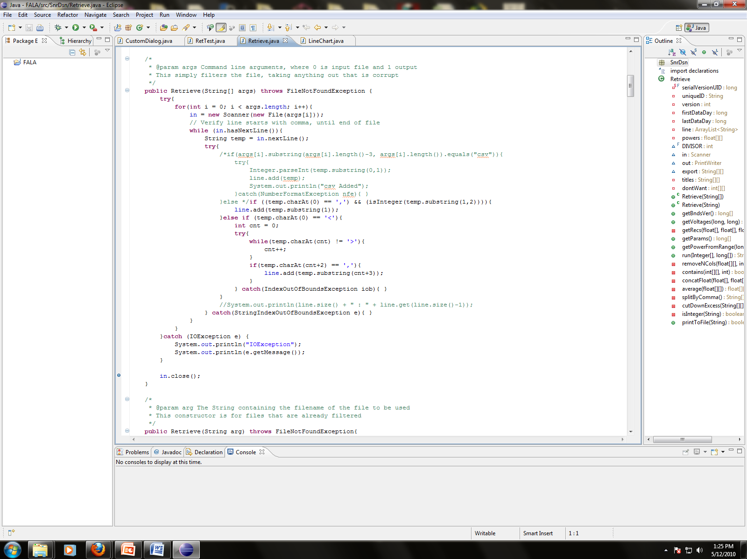
Source Code Development
Eclipse IDE (Eclipse.org)

Slide 39
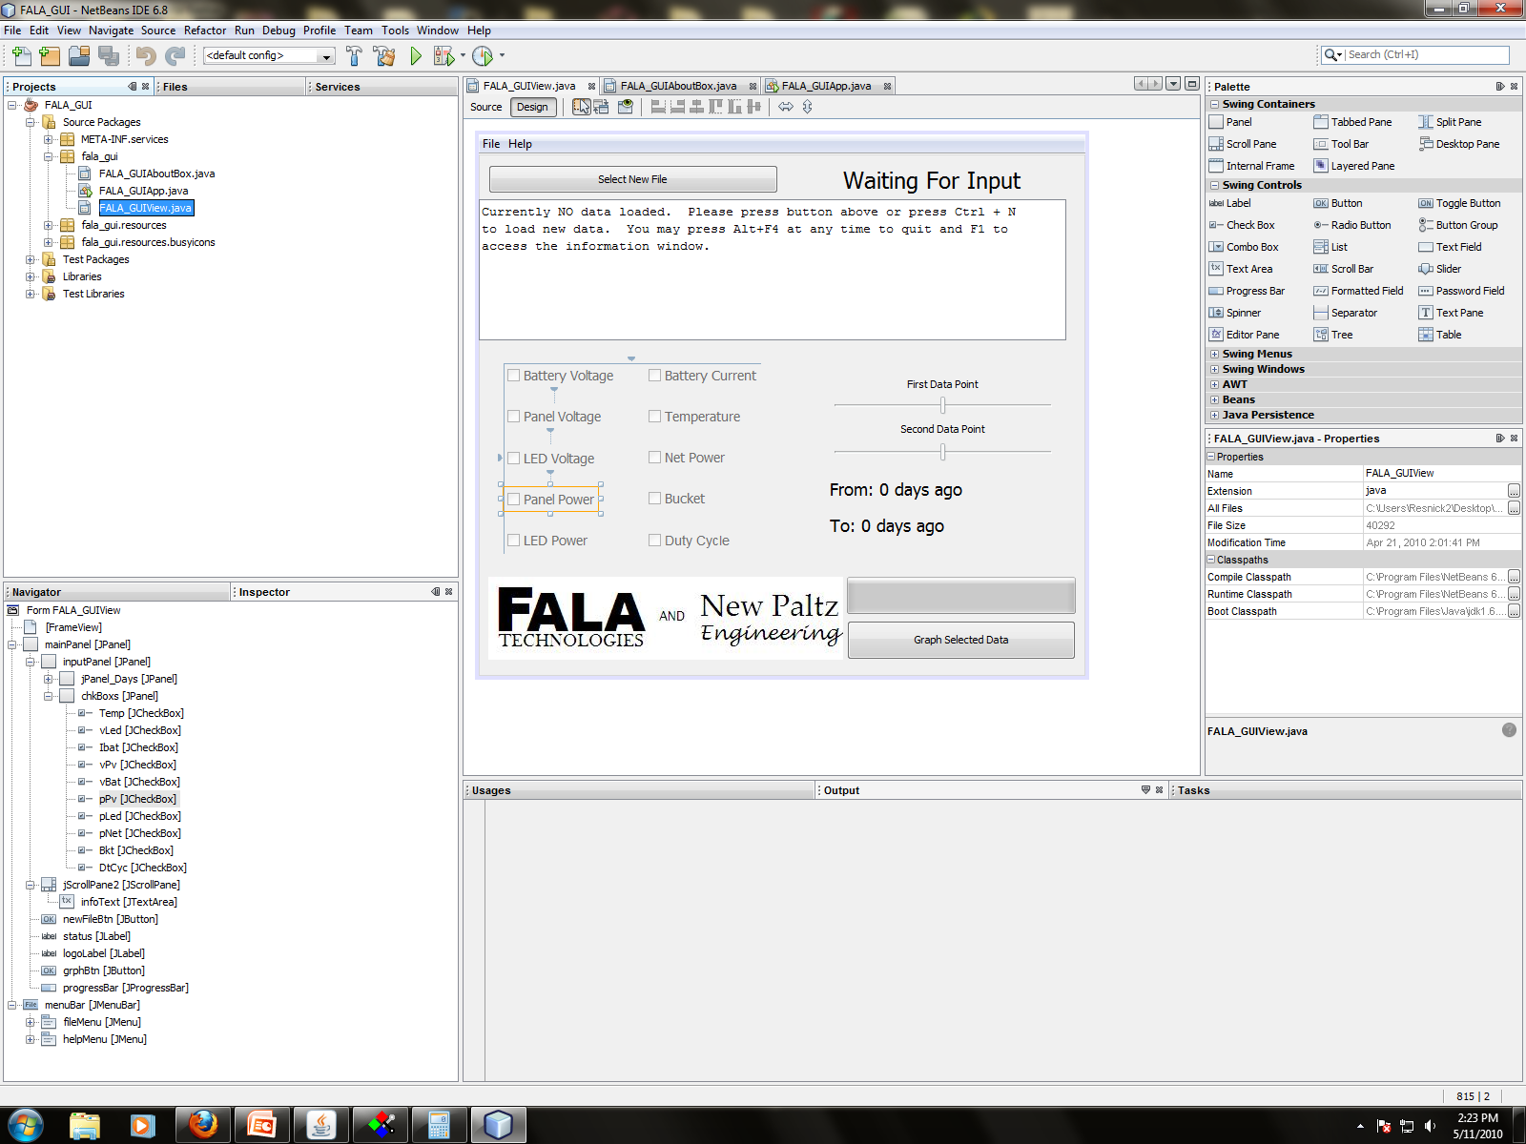
GUI Development
NetBeans (Netbeans.org)

Slide 40
GUI Example

Slide 41
Design Constraints
Economic
Manufacturability
Social, Political, and Environmental
Sustainability

Slide 42
Standards
RS-232
TTL
SPI
SOIC
PDIP
SD

Slide 43
Conclusion
Real project – real experience
Don’t reinvent the wheel
Communication is critical

Slide 44
Special Thanks to:
FALA Technologies
Luke Buschmann
Michel Rigaud
Dr. Baback Izadi

Slide 45
Questions?

